Slide 1
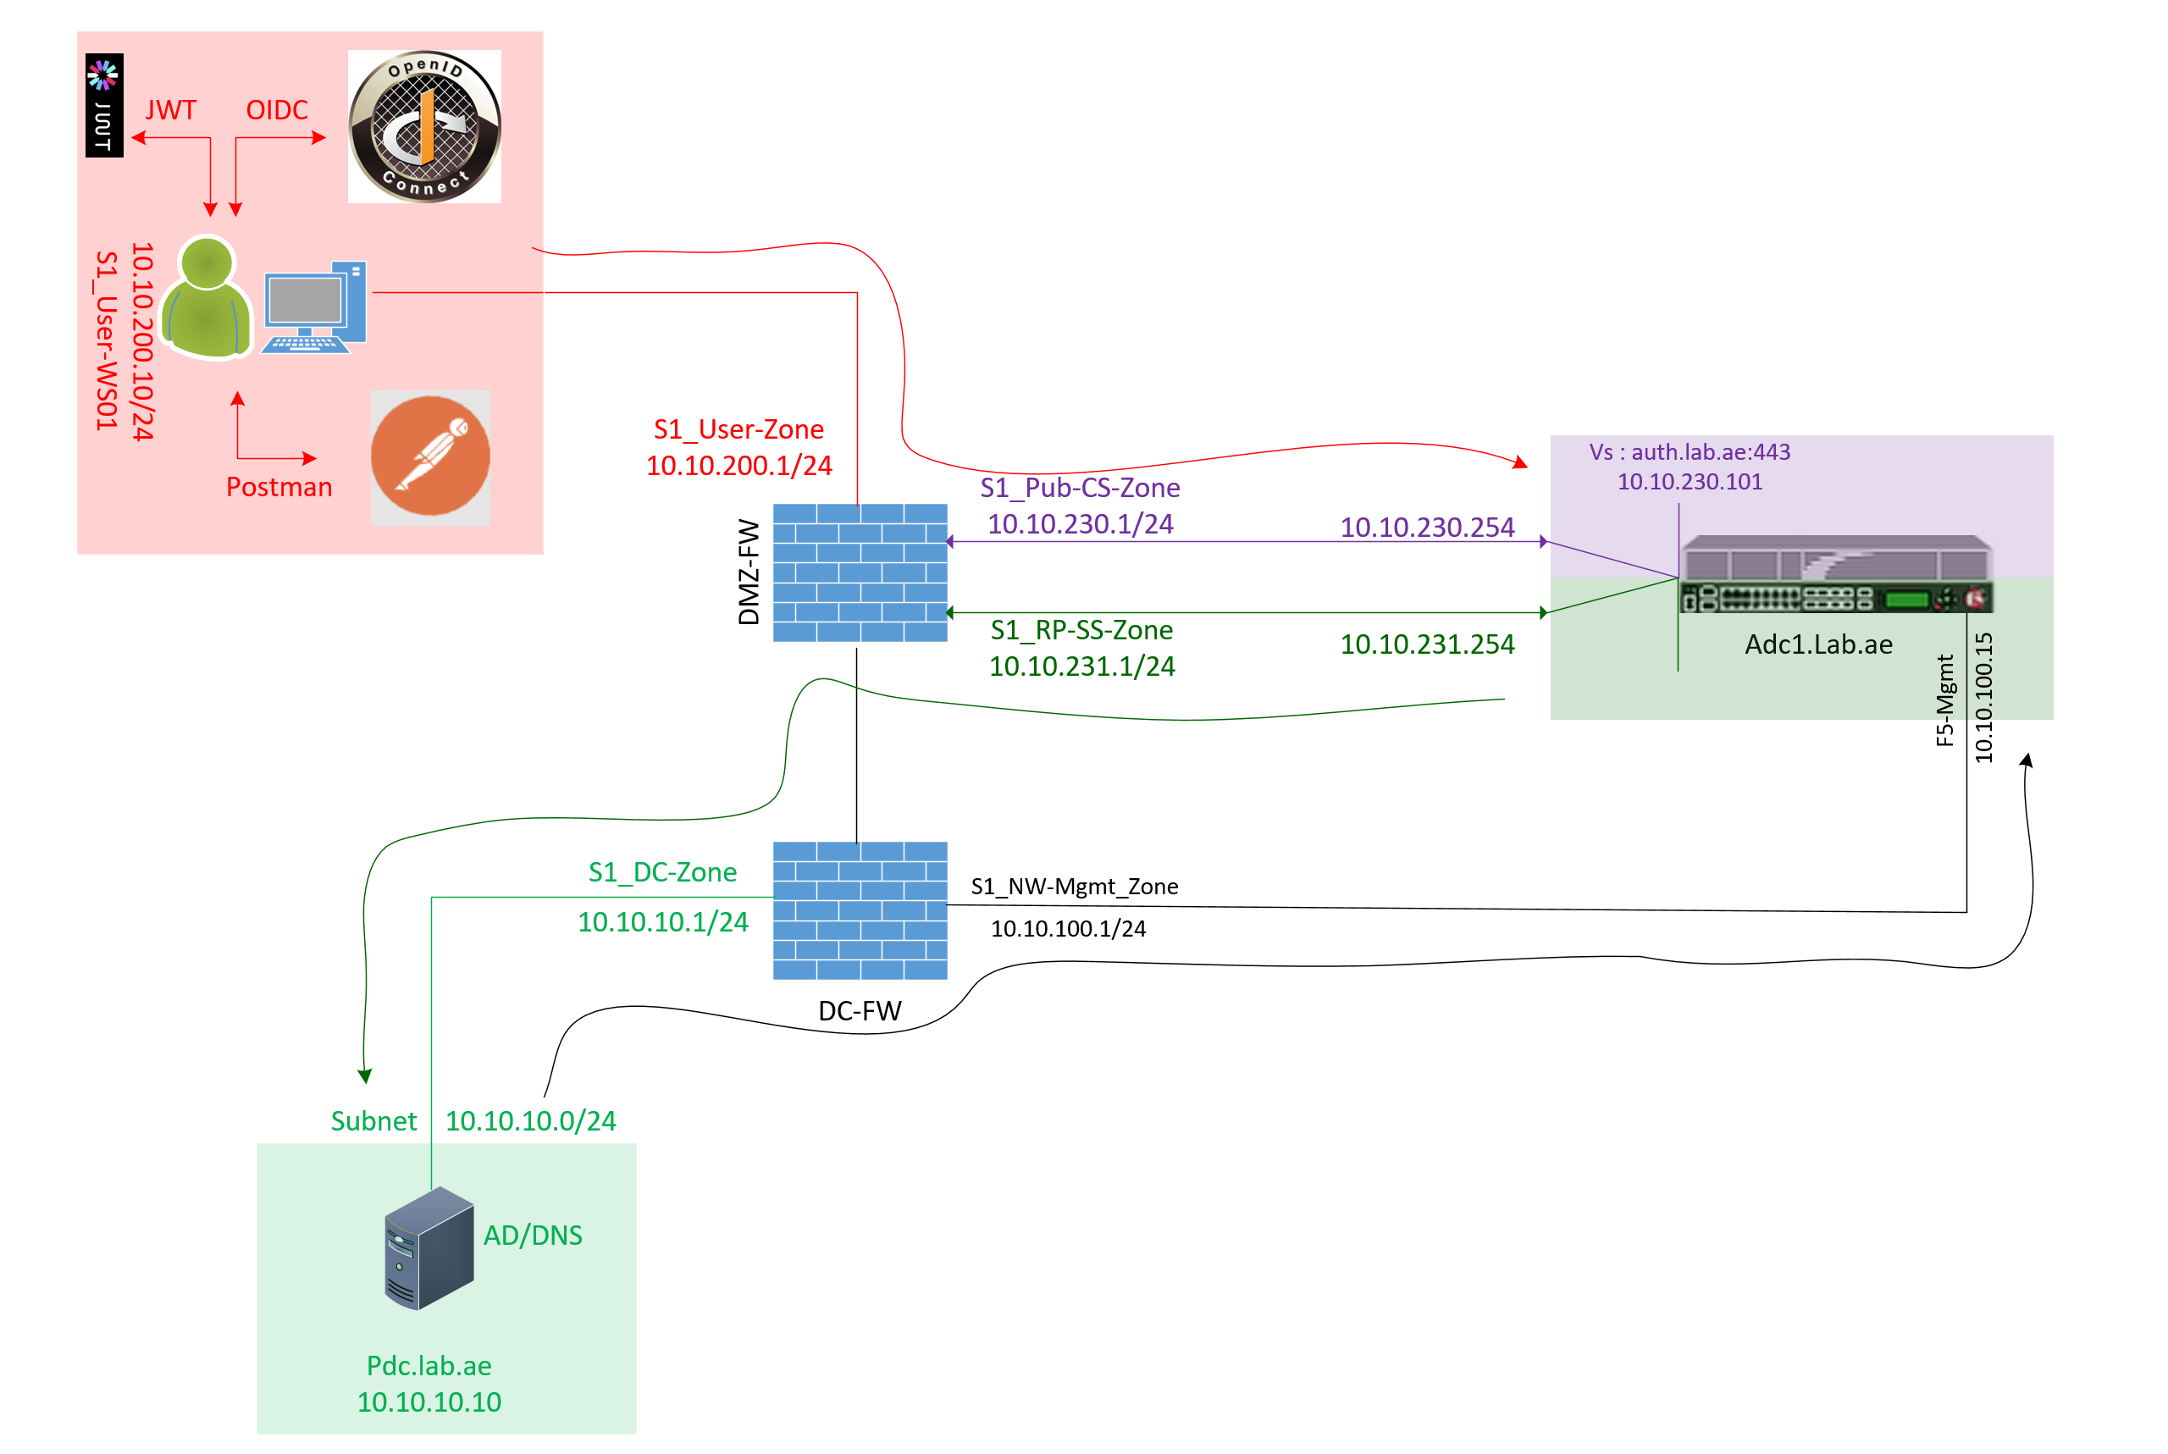

F5 APM Learning with
Alexander S
Chapter 04 – Test OAuth Authorization Code Flow using tools such as the OIDC Debugger and Postman

Slide 2
I highly recommended to watch Chapter 03 first,
  Because that explains how APM implemented as an OAuth Authorization Server using the Open ID Connect Code Flow.
  Which provides you essential background for this chapter.

Slide 3
Our LAB Setup for the Oauth Testing
1. We access the F5 management IP from the AD/DNS server:
  10.10.10.10 --> 10.10.100.15
2. For the OAuth testing, we will use the workstation: User-WS1
  From this workstation:
  Access https://oidcdebugger.com/
    The OIDC as the OAuth Client to retrieve the authorization code.
  Access https://auth.lab.ae/
    This is the APM Authorization Server URL for user authentication and consent approval.
  We use Postman (installed in this workstation)
    Postman acts as the OAuth Client to connect to the Authorization Server and obtain:
      Access Token & ID Token
  We access https://www.jwt.io/
    To decode the access token & verify the scopes & claims.
3. F5 Server-Side Self IP (10.10.231.254) connects to the AD server (10.10.10.10)
  For user authentication and AD Query using LDAP port tcp/389
  10.10.231.254 --> 10.10.10.10 tcp/389
4. All necessary ports are opened on the firewall.
https://oidcdebugger.com/
https://www.jwt.io/

Slide 4
Step 01 : Find the Discovery URL of Auth Server
https://auth.lab.ae//f5-oauth2/v1/.well-known/openid-configuration
Step 02 : Make sure the Discovery URL is accessible from client machine
We have tested. It is accessible and we retrieved lot about oAuth Auth Server

Slide 5
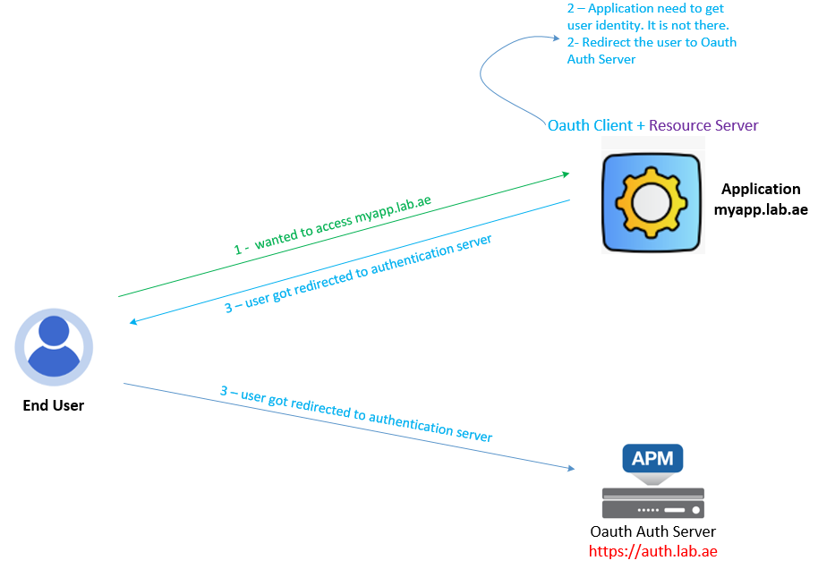
Step 03 : Authorize URI
If the user is not authenticated, the OAuth Client role is responsible for redirecting the user to the OAuth Authorization Server for authentication.
This Authorize URI is used for this redirection.

Slide 6
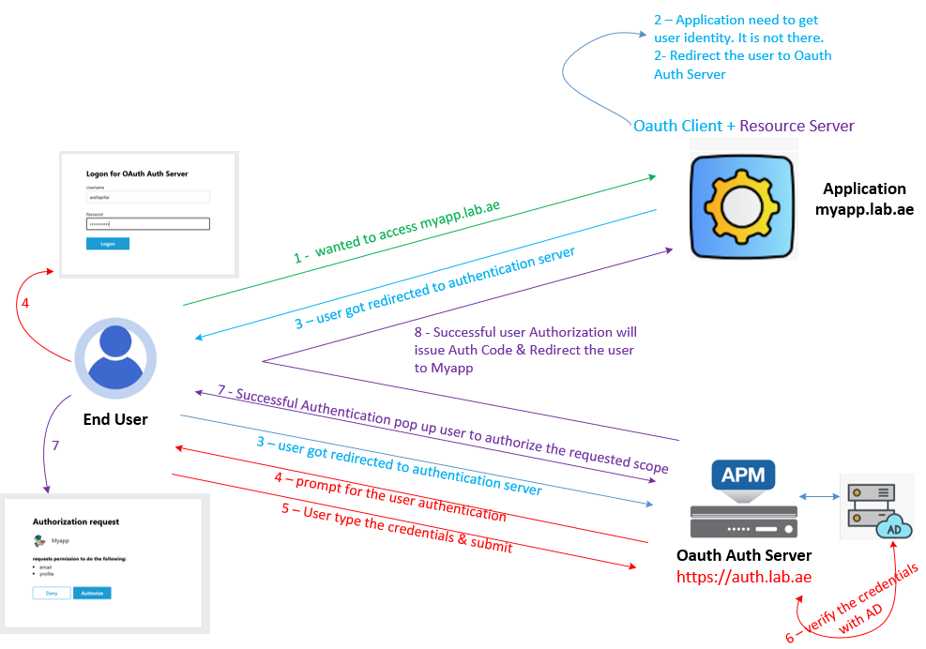
Step 04 : Redirect URI
When oAuth Auth Server receives the valid oAuth request from oAuth Client.
  It prompt for the User Authentication & Consent
  Based Successful User Authentication & Consent - oAuth Auth Server will issue Auth Code & Redirect the user to oAuth client
  For this redirection - oAuth Auth Server required this redirect URL.
  So, oAuth Client must include this redirect URI on the oAuth Request.

Slide 7
Step 05 : Client App to register each oAuth Client
It is always good security practice to configure the client application for Each oAuth client in F5 APM Auth Server.
In our case, we have configured the client application for OpenID-Connect-Debugger.
Also, we have added this redirect URI into this client application.
Adding this Redirect URI into Client Application is called as Client Registration.
If the Redirect URI is not added correctly than the APM refuses the oAuth Client request.
app1
app2
app3

Slide 8
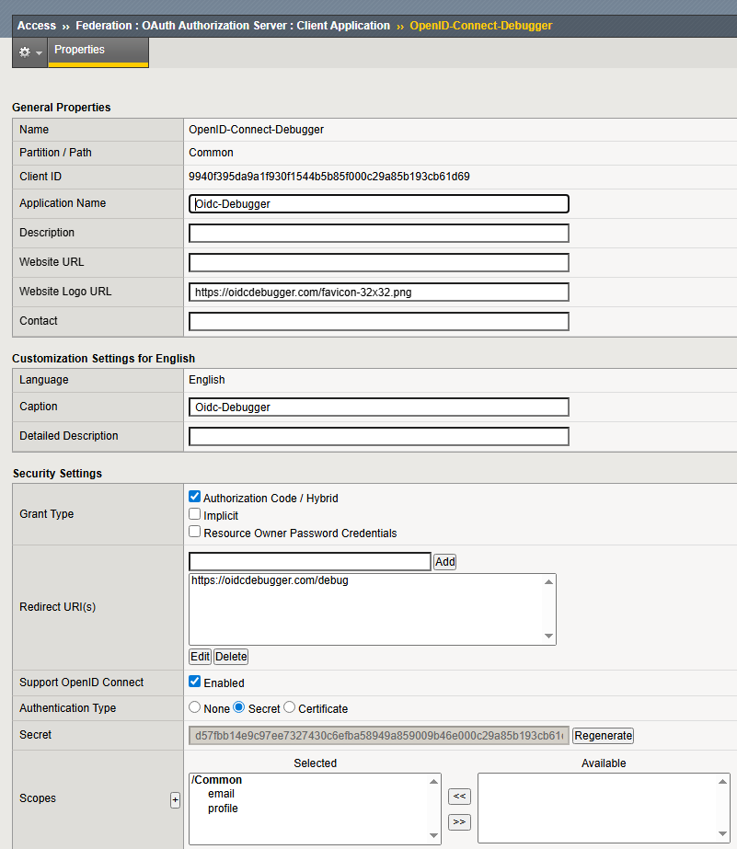
Step 05 : Client App to register each oAuth Client
It is always good security practice to configure the client application for Each oAuth client in F5 APM Auth Server.
In our case, we have configured the client application for OpenID-Connect-Debugger.
Also, we have added this redirect URI into this client application.
Adding this Redirect URI into Client Application is called as Client Registration.
If the Redirect URI is not added correctly than the APM refuses the oAuth Client request.

Slide 9
Step 06 : Client ID & Client Secret
When you configure the Client application in F5 APM – It automatically generates the unique client ID and secret.
Later oAuth client will use this client ID & Secret to get the Auth Code, Access Token and ID Token.
In our case - In this process - We are trying to get Auth code - For this we required the client ID.

Slide 10
Step 07 : oAuth Scope
Oauth Auth server configured to provide the email and profile if oAuth client request.
So, tell this is Open ID and add the scope email and profile on the oAuth Client request.

Slide 11
Step 08 : Verify the oAuth Client Request & Issues Auth Code
F5 APM receives this request from client browser.
  It checks that the client ID is valid
  Also, It confirm the redirect URI is matching
  Also, it confirm the respose_type is code flow
If all these information is correct - than the APM consider this as a valid oAuth client request and redirects the user to F5 APM login page for authentication.
Here user types the AD username and Password to login
APM validates the credentials in its User ID database. In our case it is AD. The successful login - Prompt for the user consent - Let us read & authorize the consent
Once the user approved the consent - APM issues the Authorization code and redirect the user to oAuth client using the redirect URI.
Awesome! We got the Authorization Code.

Slide 12
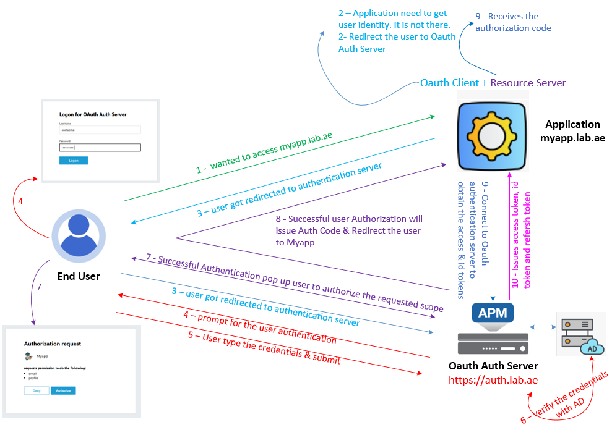

Step 09 : Token Exchange
oAuth Client sends the Token request to oAuth Server.
oAuth Server validates the request and issues the Access token, ID token and Refresh token.

Slide 13
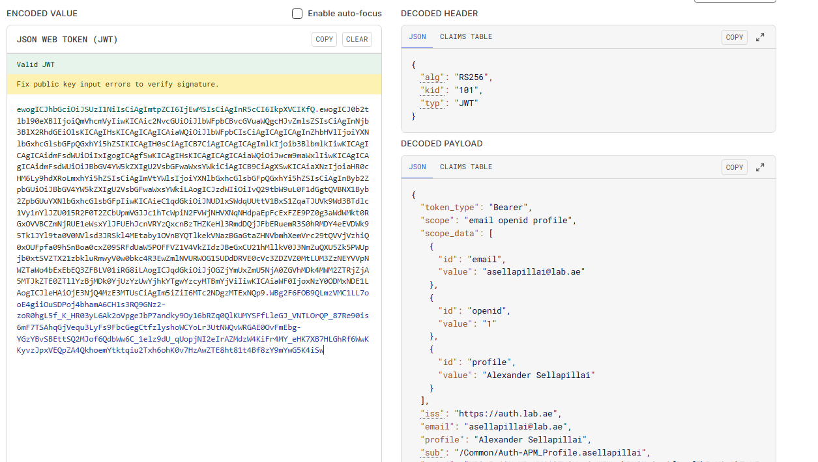
Step 10 : Decode the Access token and see the Scope and Claim Values
These tokens are JWT tokens.
So, Let us decode these tokens using https://www.jwt.io
To decode this, open another tab and type https://www.jwt.io.
It opens link this - Here copy and paste the access token
Here - you will see the Scope Request and Response Data and Claim values like this.
Scope Values
Claim Values

Slide 14


Post your comments !!! - If you tested oAuth using OIDC Debugger, Postman and jwt.io
Scope Values
Claim Values

Slide 15
Chapter 04 – Test OAuth Authorization Code Flow using tools such as the OIDC Debugger and Postman
This concludes Chapter 04, where we successfully tested the OAuth Authorization Code Flow using tools such as the OIDC Debugger and Postman.
From the test results,
👉 We retrieved the access token, ID token, and refresh token.
👉 We also decoded the access token and verified the scope and claim values.
Please continue watching Chapter 05.
👉 In Chapter 05, we will move on to Integrating F5 APM OpenID Authentication with Oracle APEX Application.
Thank you for watching!!!

